Slide 1
Chapter 4 Objectives
The CCNA Topics Covered in this chapter include:
  Ethernet Networking
  CSMA/CD
  Ethernet Cabling
  Types of transmission
  Hub ,Switch, and Router
  Cisco’s Three-Layer Model

Slide 2
Ethernet Networking
Ethernet is a contention media access method that allows all hosts on a network to share the same bandwidth of a link.
Ethernet is popular because it’s readily scalable, meaning that it’s comparatively easy to integrate new technologies, such as Fast Ethernet and Gigabit Ethernet, into an existing network infrastructure.
Ethernet = 10 Mbps
Fast Ethernet = 100 Mbps
Gigabit Ethernet = 1000 Mbps
Terabit Ethernet = 1,000,000 Mbps

Slide 3
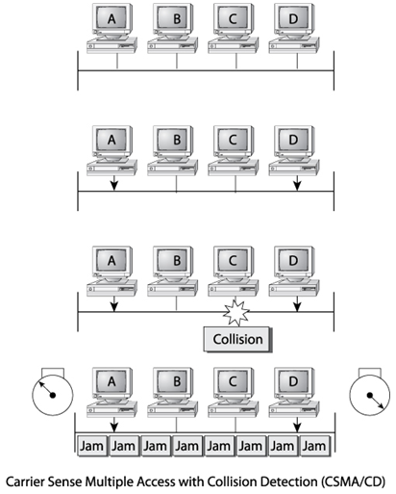
Ethernet Collision Detection
CSMA/CD

Slide 4

Ethernet
Carrier Sense Multiple Access
Collision Detection
Transmits signal
Detects signal
Collision detected
Characteristics
Description
Access Method
CSMA/CD
Transfer Speed
Standard Ethernet – 10 Mbps
Fast Ethernet – 100 Mbps
Gigabit Ethernet – 1 Gbps (1000 Mbps)

Slide 5
Ethernet Cabling
Three types of Ethernet cables are available:
  Straight-through cable
  Crossover cable
  Rolled cable
We will look at each in the following sections.

Slide 6
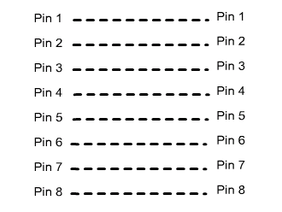
Straight Through
The straight-through cable is used to connect
  Switch to router
  Switch to PC or server
  Hub to PC or server
Straight cable pin-out

Slide 7
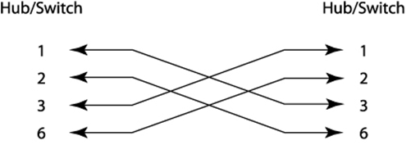
Crossover Cable
The crossover cable can be used to connect
Switch to switch
Hub to hub
Host to host
Hub to switch
Router direct to host

Slide 8
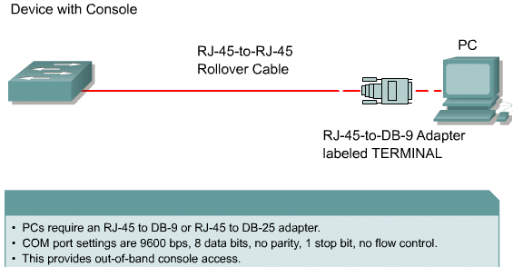
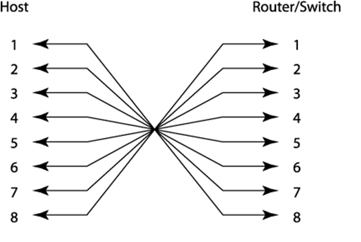
Rolled Cable
Although rolled cable isn’t used to connect any Ethernet connections together, you can use a rolled Ethernet cable to connect a host to a router console serial communication (com) port.

Slide 9
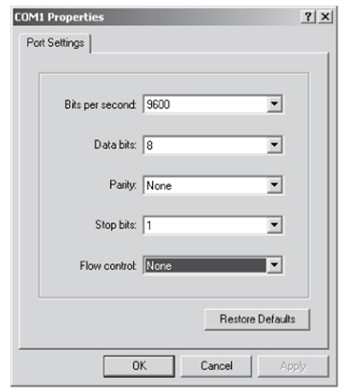
Using Hyper Terminal
Notice the settings for Hyper Terminal

Slide 10
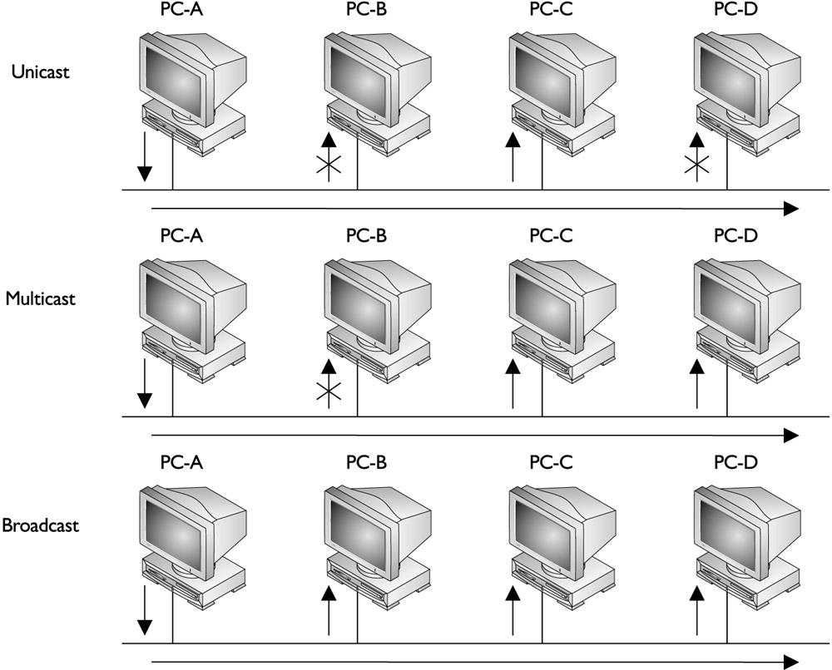

Types of Transmission
Unicast
Multicast
Broadcast
Unicast
Broadcast
Multicast

Slide 11
Broadcast Domain
A group of devices in the network that receive one another’s broadcast messages
Collision Domain
A group of devices that connect to the same physical media
so that if two devices access the media at the same time, the
result is a collision of the two signals.

Slide 12
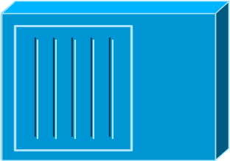

Device used at Layer 1 - HUB
Physical
Hub
A
B
C
D
  All devices are in the same collision domain.
  All devices are in the same broadcast domain.
  Devices share the same bandwidth.

Slide 13
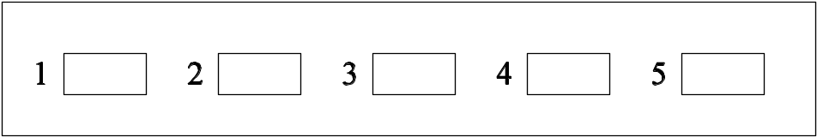
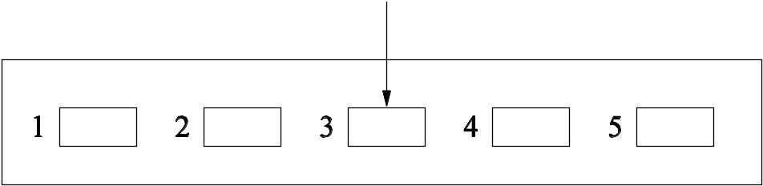
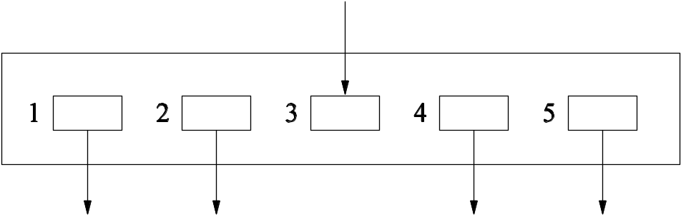
A Hub in Action
Disadvantages of Hubs
Advantages of Hubs
Wasteful of bandwidth
  - Why should host B have to share its link with a conversation between A and D?
Poor security
  - Why should host B get to share its link with a conversation between A and D?
  - Packet sniffer” on one port can monitor the traffic of all of the ports
Can’t have redundancy
Easy to Understand
Easy to Implement
…so they’re cheap

Slide 14
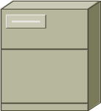


Hubs and collision domains
More end stations means more collisions.
CSMA/CD is used.

Slide 15
Layer 2
MAC Layer—802.3
Number of Bytes
8
6
6
2
Variable
4
Preamble
Destination Address
Source Address
Length
Data
FCS
Ethernet II uses “Type” here and
does not use 802.2.
  0000.0C xx.xxxx
IEEE Assigned
Vendor Assigned
  MAC Address
synchronize senders and receivers

Slide 16

Device used at Layer 2
Data-Link
1
2
3
4
Switch
  Each segment has its own collision domain.
  All segments are in the same broadcast domain.

Slide 17
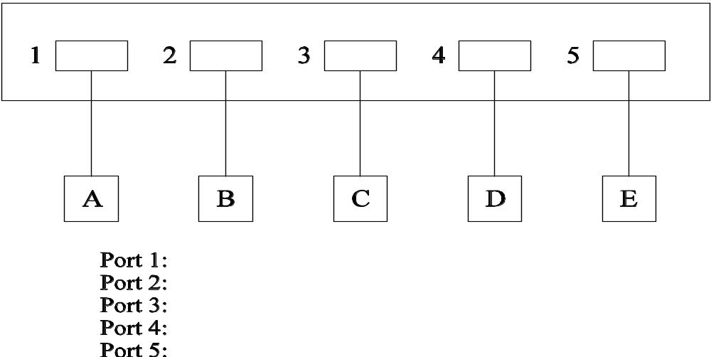
A Switch in Action

Slide 18

A Switch in Action

Slide 19
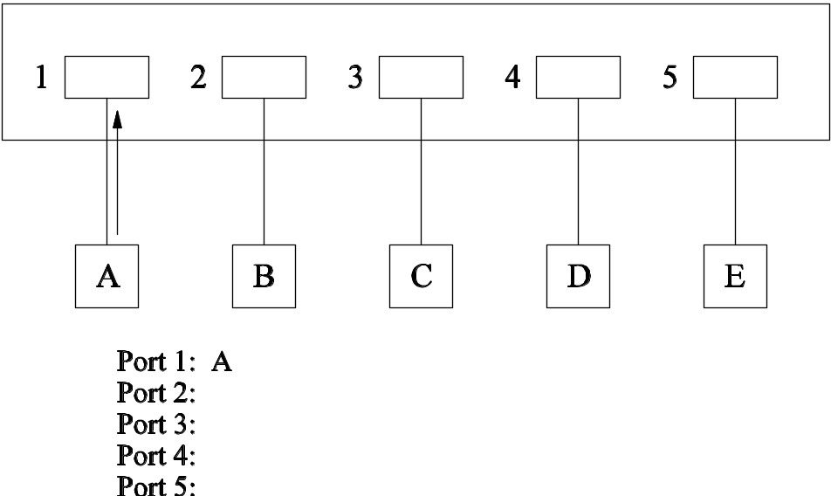
A Switch in Action

Slide 20
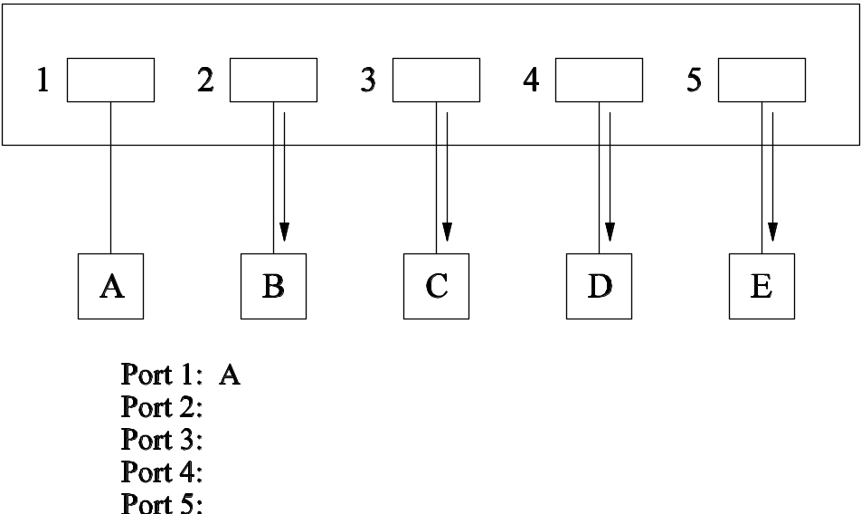
A Switch in Action

Slide 21
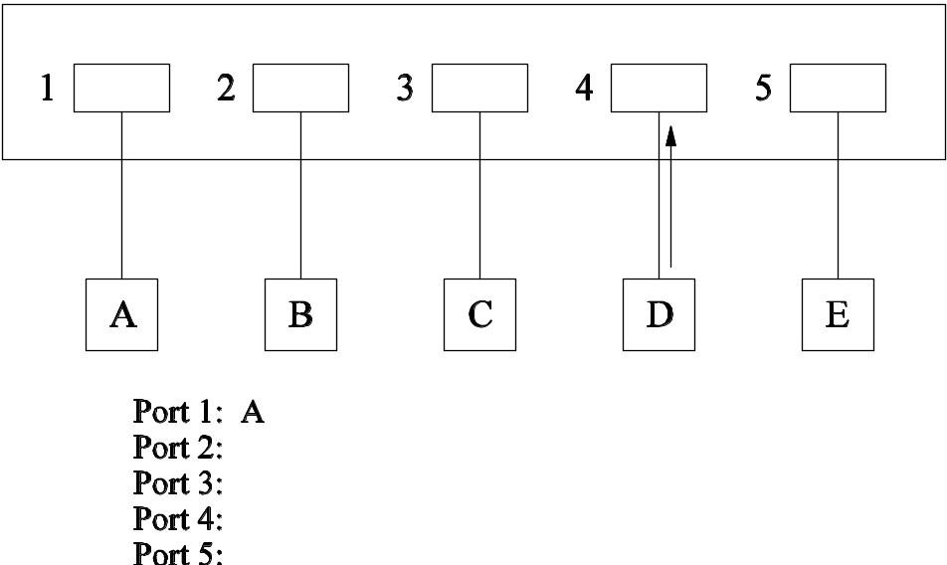
A Switch in Action

Slide 22

A Switch in Action

Slide 23

A Switch in Action

Slide 24

A Switch in Action

Slide 25
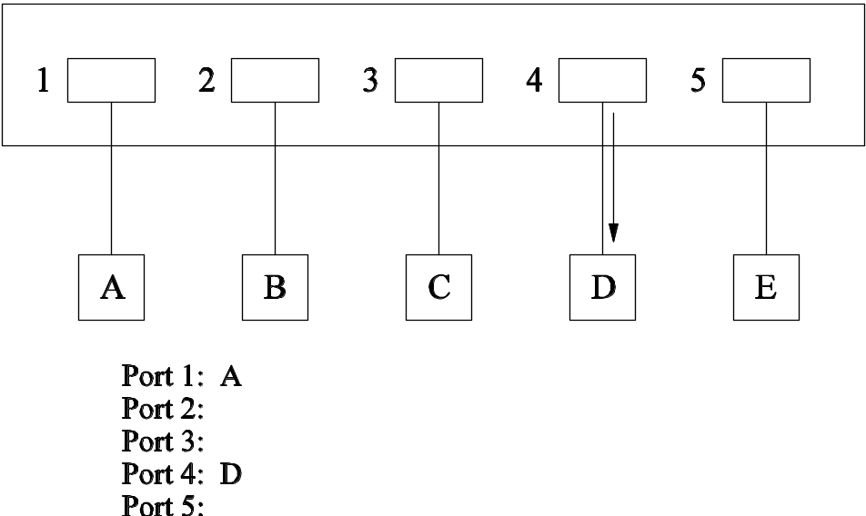
A Switch in Action

Slide 26
Switch
Switch
Memory
Each segment is its own collision domain.
Broadcasts are forwarded to all segments.

Slide 27




Device used at Layer 3
Routers operate at Layer 3. i.e Network Layer.
- The protocols at network layer are IP, IPX, Apple Talk etc..
Connects multiple networks together.
Finds the best path to reach the destination.
Routers separate segments into unique collision and
broadcast domains.

Slide 28

Summary:
Hub – One collision domain and one broadcast domain
irrespective of number of devices connected to it.
Switch – Switches and bridges breakup collision domains.
Router – Router breakup collision as well as broadcast domains.
Hub
Bridge
Switch
Router
Collision Domains:
1 4 4 4
Broadcast Domains:
1 1 1 4

Slide 29


Cisco’s Three-Layer Model
The following are the three layers and their typical functions:
  The core layer: backbone
  The distribution layer: routing
  The access layer: switching
Core Layer
Distribution
Layer
Access
Layer

